Slide 1
AI and ML for dummies
Artificial Intelligence
IT Group 682.19E
By Sahand Salmani Valikhanlou

Slide 2
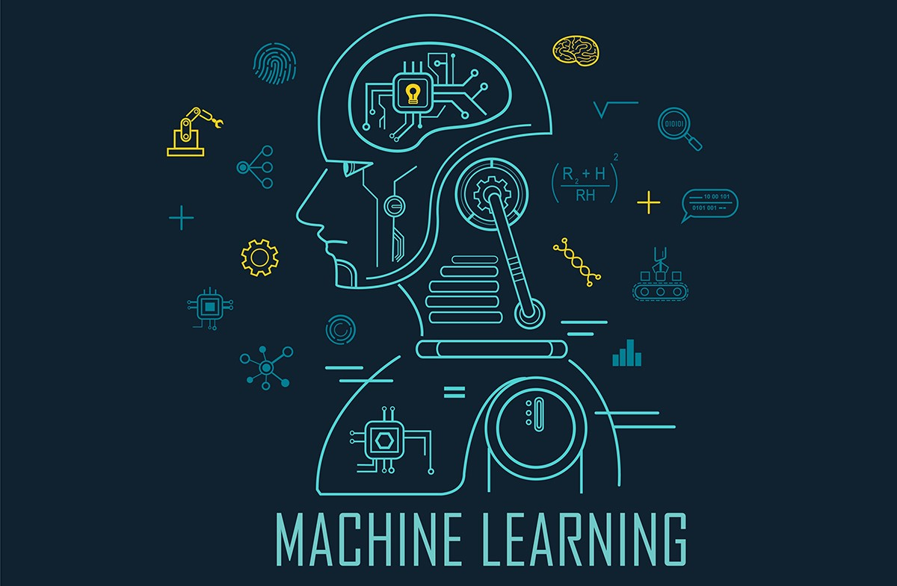
What is AI
Types of AI
What is ML
Types of ML
Difference between AI and ML
Supervised ML algorithms
Linear Regression
How LR works
Implementation
Cost Function
Cost Function Visualization
Gradient Descent
Gradient Descent Visualization
Outline

Slide 3

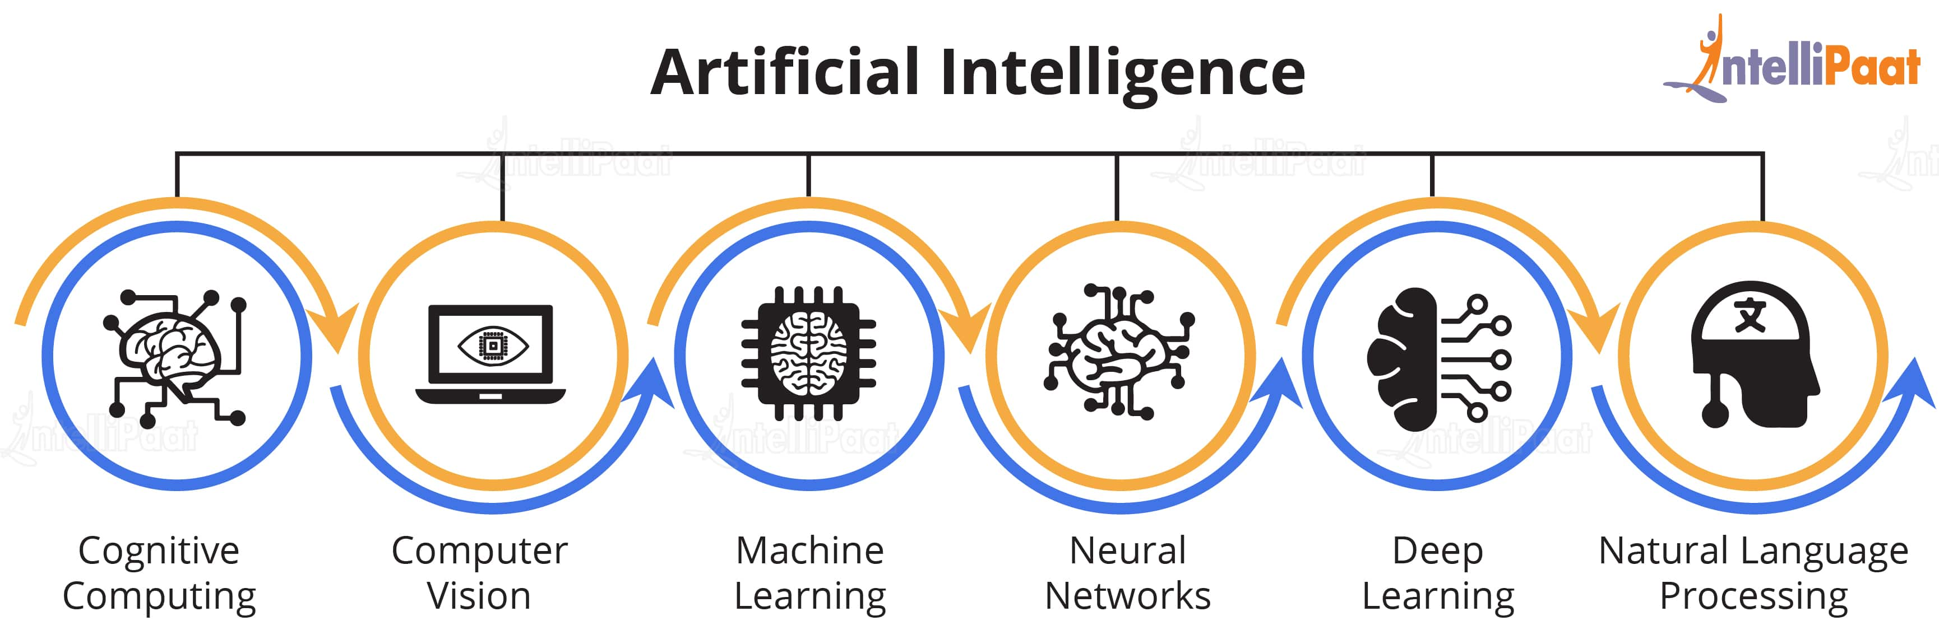
In the simplest terms, AI which stands for artificial intelligence refers to systems or machines that mimic human intelligence to perform tasks and can iteratively improve themselves based on the information they collect.
What is AI
Introduction

Slide 4
Reactive
Theory of Mind
Technology capable of responding to external stimuli in real time, but unable to build a memory base and store information for future use.
The concept of AI that can sense and respond to human emotions as well as perform the tasks of limited memory machines.
Limited Memory
Self Aware
The final stage of AI where machines can not only recognize the emotions of others, but also have a sense of self and a human-level intelligence.
Machines that can store knowledge and use it to learn and train for future tasks.
Types of Ai

Slide 5
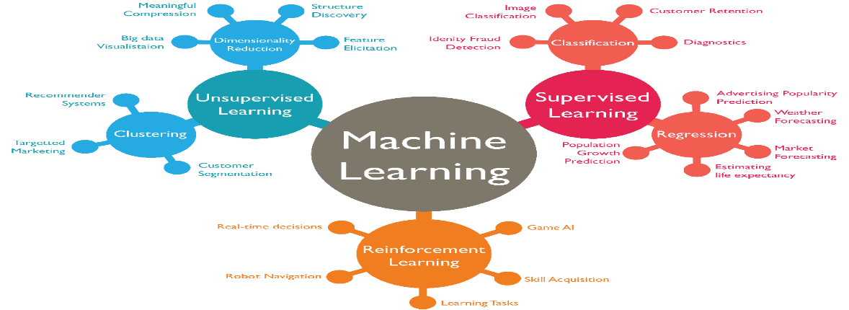
ML(Machine Learning) in simplest form is defined as:
Finding patterns for any input that we can represent as numeric which also has numeric output is called ML.
Machine learning (ML) is a type of artificial intelligence (AI) that allows software applications to become more accurate at predicting outcomes without being explicitly programmed to do so. Machine learning algorithms use historical data as input to predict new output values.
What is ML
Introduction

Slide 6
Supervised
Reinforcement
This type of machine learning feeds historical input and output data in machine learning algorithms, with processing in between each input/output pair that allows the algorithm to shift the model to create outputs as closely aligned with the desired result as possible.
Reinforcement learning is the closest machine learning type to how humans learn. The algorithm or agent used learns by interacting with its environment and getting a positive or negative reward. Common algorithms include temporal difference, deep adversarial networks, and Q-learning.
Unsupervised
While supervised learning requires users to help the machine learn, unsupervised learning doesn't use the same labeled training sets and data. Instead, the machine looks for less obvious patterns in the data.
Types of ML

Slide 7

AI solves tasks that require human intelligence while ML is a subset of artificial intelligence that solves specific tasks by learning from data and making predictions. This means that all machine learning is AI, but not all AI is machine learning.
Machine learning is just a way of finding pattern between input and output by AI is mimicking the human interaction for solving a problem
Difference between AI and ML
Distinction

Slide 8
Linear Regression (We will cover this here)
Logistic Regression
Support Vector machine
KNN
Decision Tree
Supervised ML algorithms

Slide 9
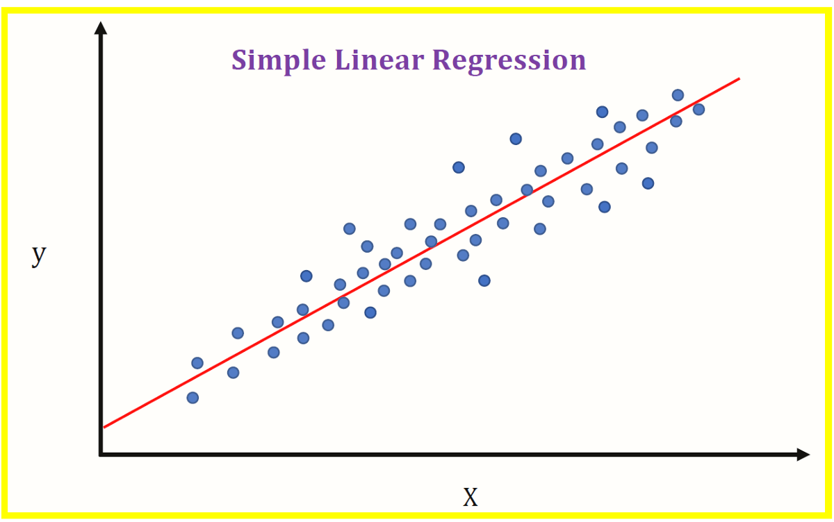
Linear regression attempts to model the relationship between two variables by fitting a linear equation (= a straight line) to the observed data. One variable is considered to be an explanatory variable (e.g. your income), and the other is considered to be a dependent variable (e.g. your expenses).
What is Linear Regression
Introduction

Slide 10
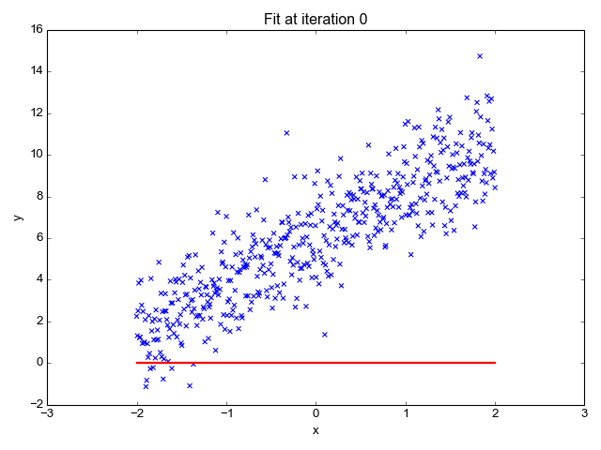
We plot our dependent variable (y-axis) against the independent variable (x-axis)
We try to plot a straight line and measure correlation
We keep changing the direction of our straight line until we get the best correlation
We extrapolate from this line to find new values on y-axis
How Linear Regression works
LR

Slide 11
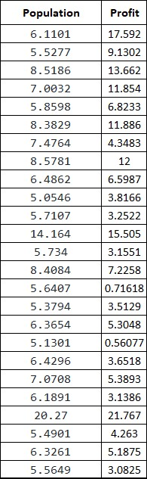

We have a dataset of profit of restaurant based on the population of the city.
First we analyze the data. We can see that our profit (y) is something that we want to predict for any value that we pass for the population which is our only x here (first feature). We can call our model as h which stand for hypothesis (our prediction model).
Then our model is as follows
$$h=w_{0}x_{0}+w_{1}x_{1}$$
We consider $x_{0}$ as 1 then our $w_{0}$ is considered as intersection with the y axis. But our $x_{1}$ is our population feature and $w_{1}$ is our population weight.
Our $w_{0}$ is not something that we should take into consideration for now because ML algorithm will find that intersection for us then ignore it for now.
Implementation
LR

Slide 12
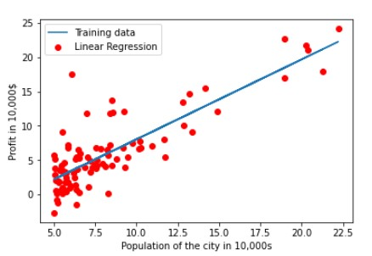
Most fit model for previous DS
LR

Slide 13
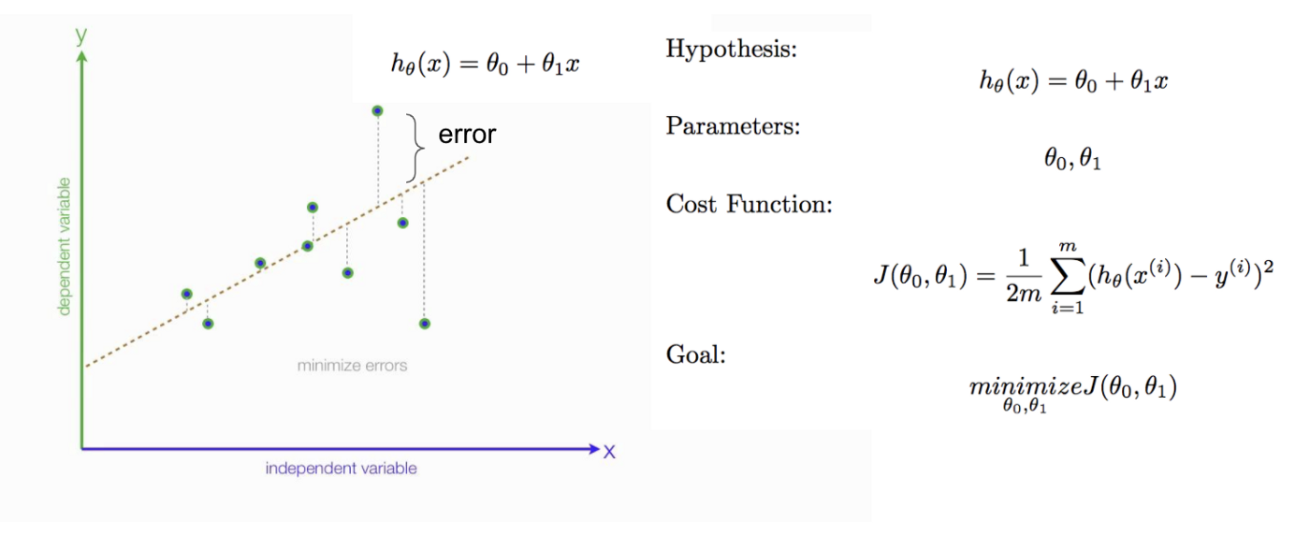

A cost function is an important parameter that determines how well a machine learning model performs for a given dataset. It calculates the difference between the expected value and predicted value and represents it as a single real number. Cost function is also called error function as well which indicates that how well our model (all the weights that we have defined) is different than the value that we have for training. For example lets assume that we have randomly initialized our weights (in here we have x for population and its corresponding w which is $w_{1}$). It will show us how far our prediction is from the specified y which we have in dataset. Keep that in mind that this cost function is only useful during training session because you have all x and their corresponding y. Our goal is to find in which weights we get the minimum value for cost function.
Cost Function
LR

Slide 14
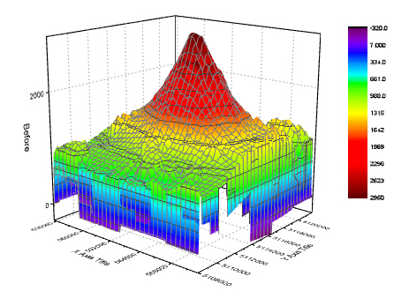
We can draw the cost function but keep that in mind for every feature means one dimension it means if you have 1 feature you will have two dimensional (x axis is for feature weights and y axis for cost functions value) graph. For two features we will have 3 dimensional graph. But for more feature we will not be able to graph it because graphing 4 or more dimensional graphs will be impossible.
Cost Function Graph
LR

Slide 15
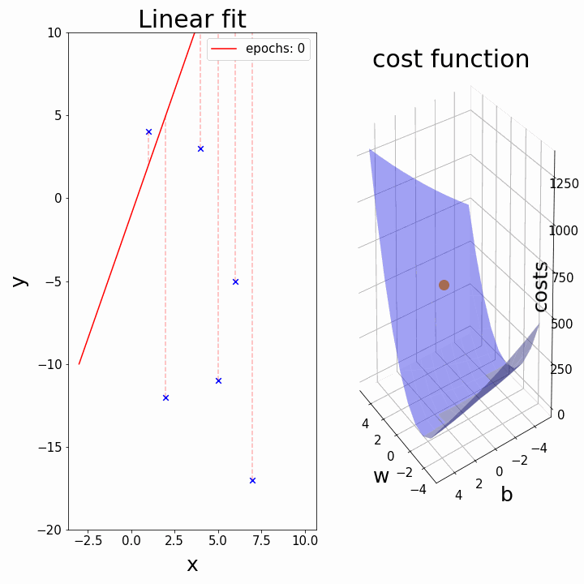
Gradient descent is an optimization algorithm which is commonly-used to train machine learning models and neural networks. Training data helps these models learn over time, and the cost function within gradient descent specifically acts as a barometer, gauging its accuracy with each iteration of parameter updates. In GD optimization we use opposite direction of partial derivative of cost function by length that we specify as alpha. Our goal in this optimization technique is to reach the global minimum value of the cost function.
Gradient Descent
LR

Slide 16
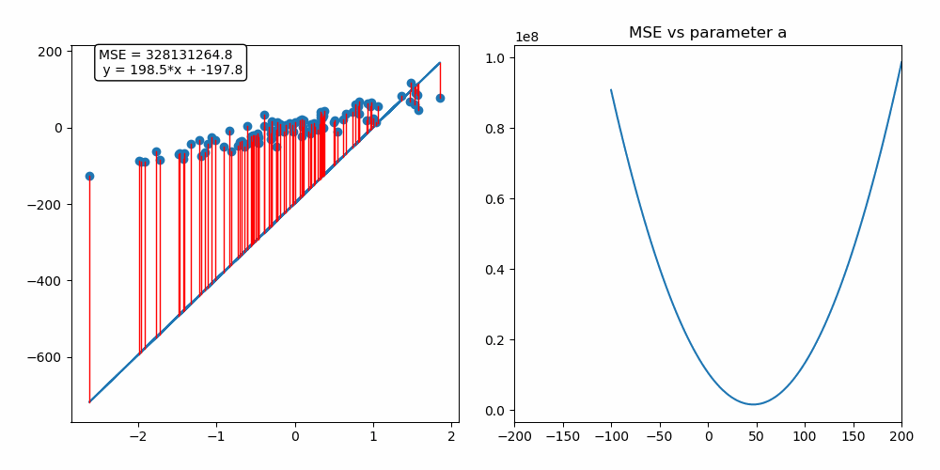
Gradient Descent Visualization for one feature
LR

Slide 17
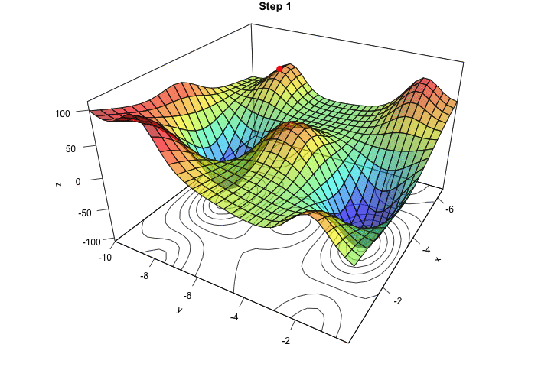
Gradient Descent Visualization for two feature
LR

Slide 18
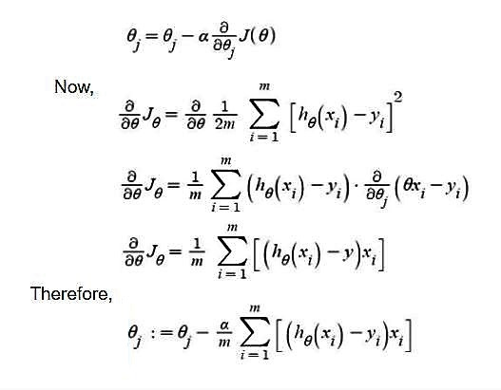
As we mentioned in previous slides, GD uses partial derivatives of cost function to go in opposite direction of partial derivatives in order to reach the global minimum. If we take partial derivatives of cost function based on the w or weights we can get the GD optimization formula.
GD is iterative optimization technique which means it uses its previous value to optimize the value of weights. There is one extra variable in that formula which is alpha. Alpha is the size of step of movement from previous position to new position. We should take alpha not too small because it will take too much iteration to reach global minimum and not too big because it will diverge if it passes the global minimum. (Divergence of GD is another topic that we can cover later)
How GD works
LR

Slide 19
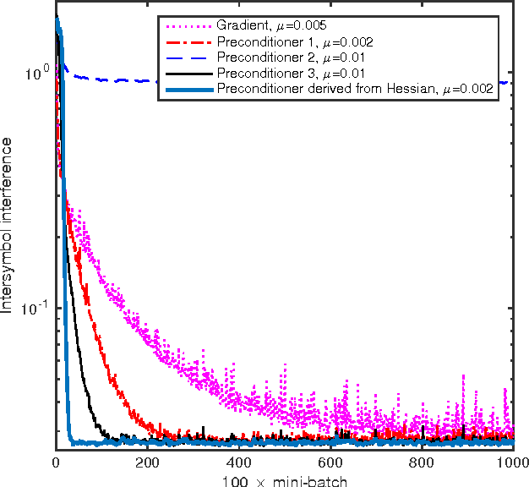
Gradient Decent is an optimization technique that is convergence. It means it will converge to specific value after specific number of iteration. In this graph, y axis is the cost function and x axis is the number of iteration for this optimization technique. As we can see all of them at some point reaches to the same value of cost function but difference between them is the value of alpha (step size which indicates length of movement from previous point to new point of weight). In most cases, cost function even after infinite number of iteration will never reach 0.
GD is convergence Optimization technique
LR

Slide 20
Thanks for your attention
Artificial Intelligence
IT Group 682.19E
By Sahand Salmani Valikhanlou

